Slide 1
Büyük Veriye Giriş
Büyük Veri Nedir?

Slide 2
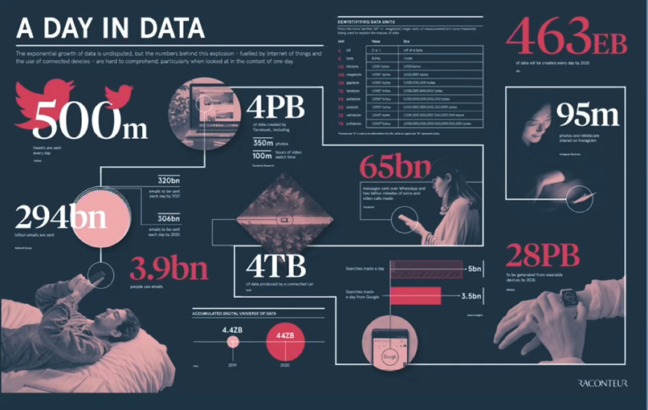
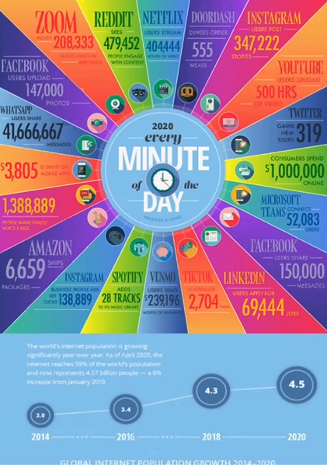
A Day in Data

Slide 3
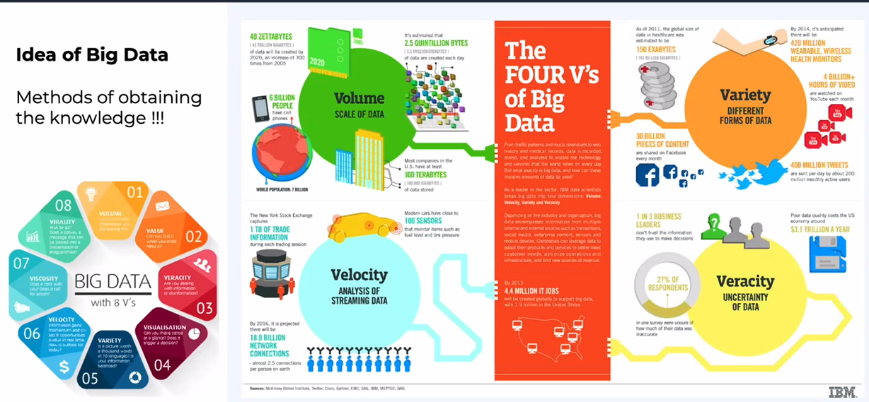
Definition of Big Data

Slide 4
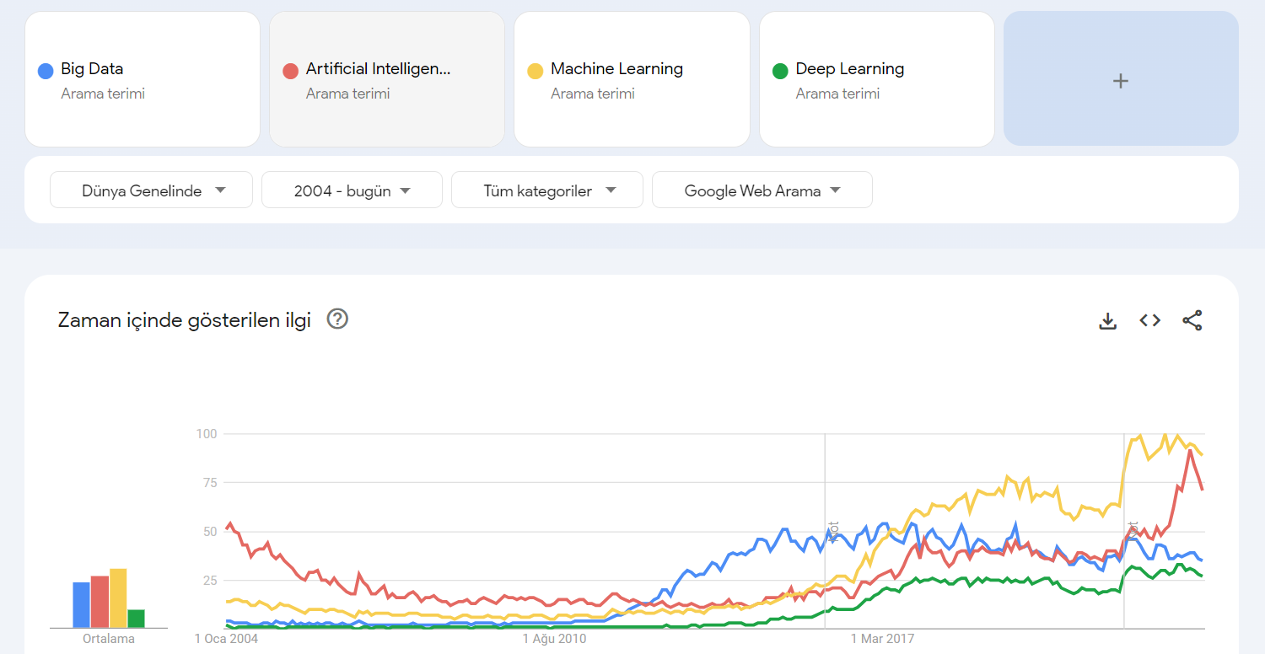
Relevance of Big Data

Slide 5
https://trends.google.com/trends/?geo=TR&hl=tr

Slide 6
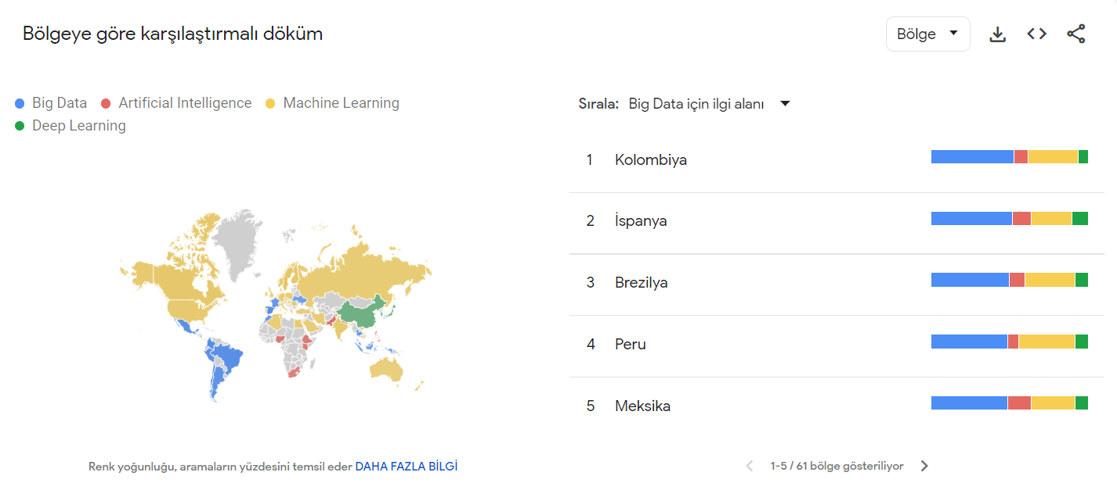

Slide 7
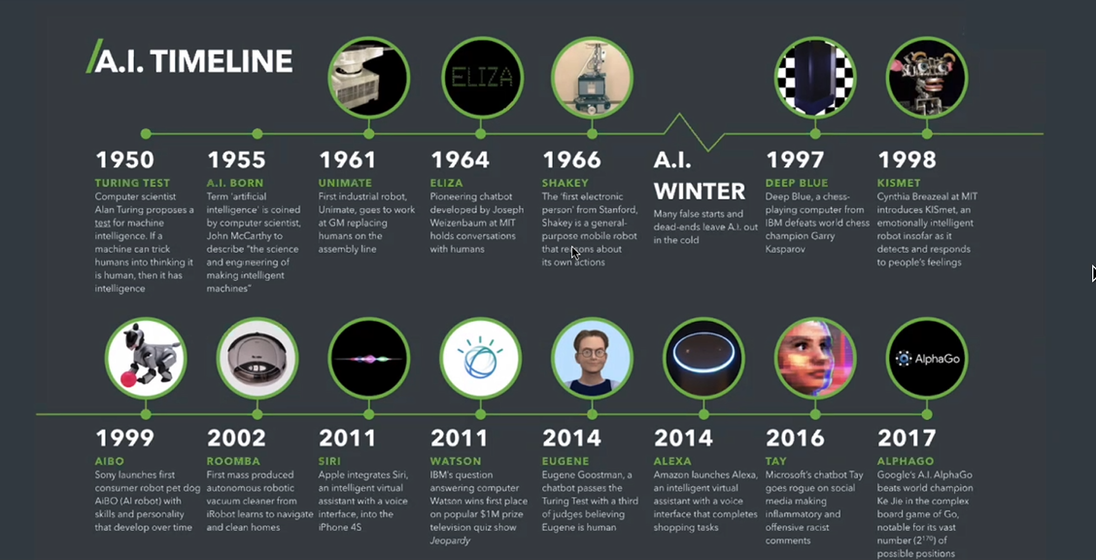
Artificial Intelligence

Slide 8
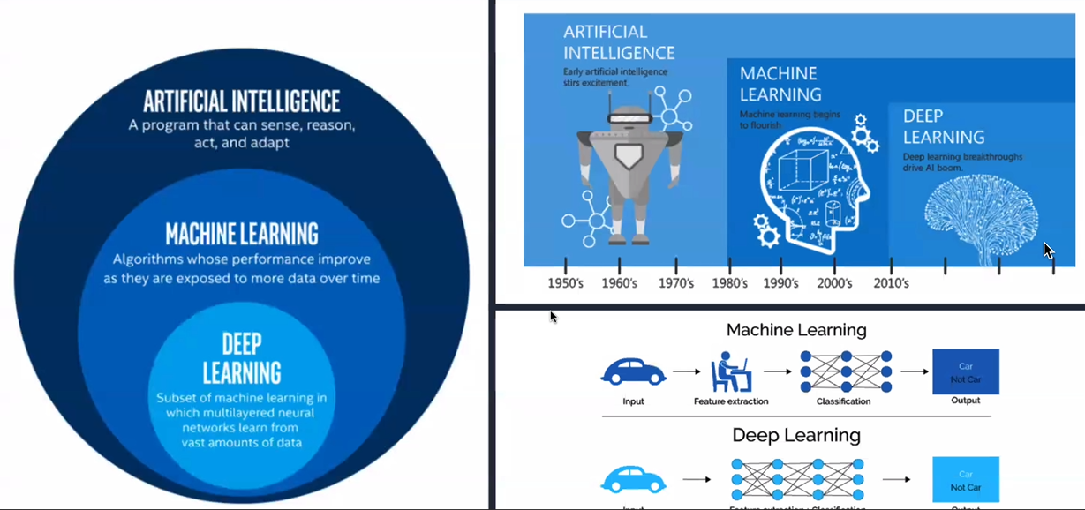
Artificial Intelligence

Slide 9
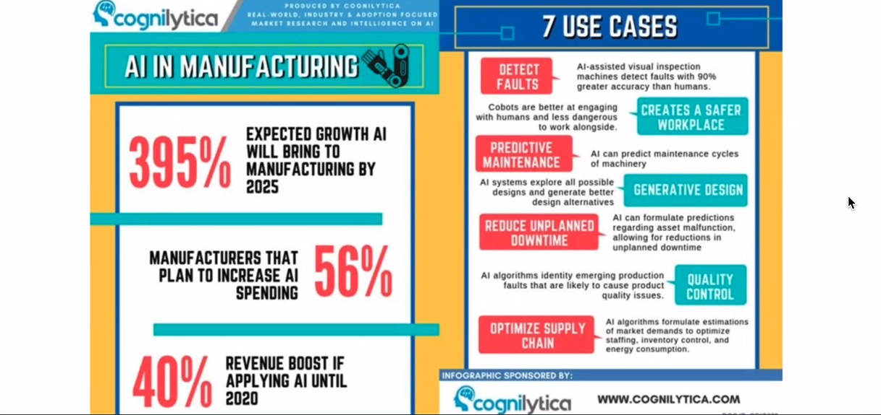
Artificial Intelligence

Slide 10
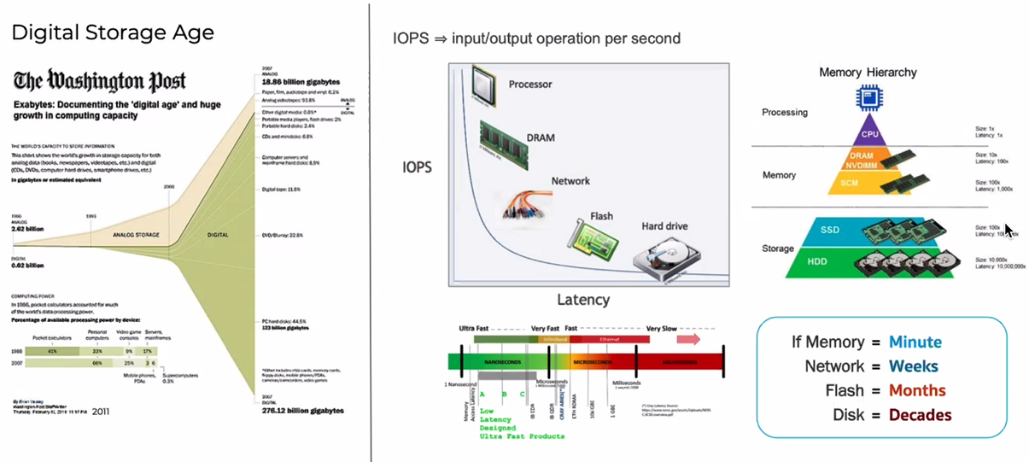
Hardware Technologies

Slide 11
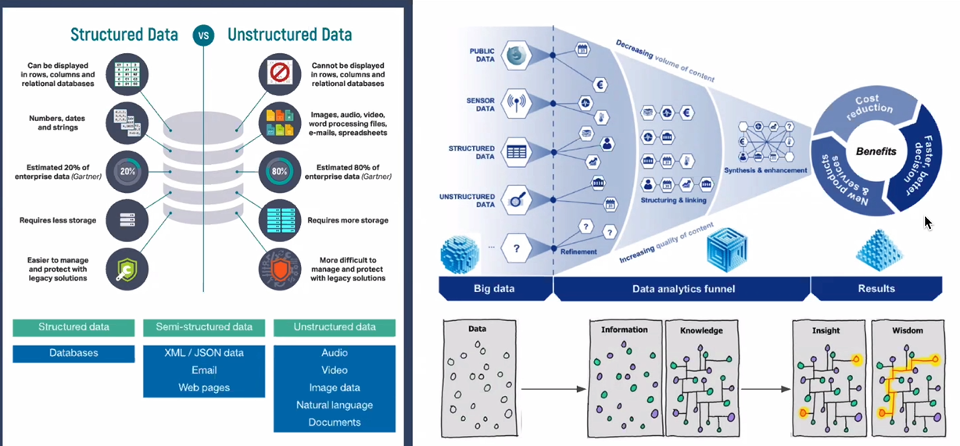
Data Structure Types

Slide 12
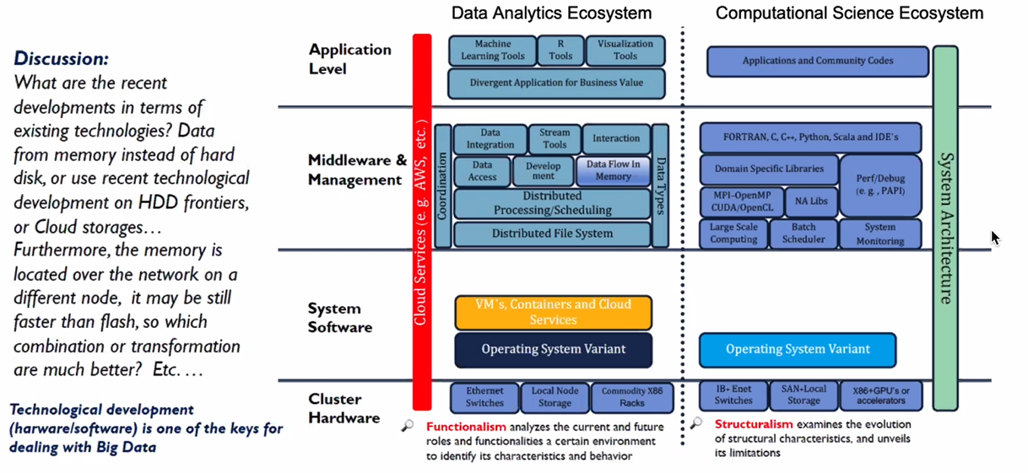
Schema for Divergent Ecosystem

Slide 13
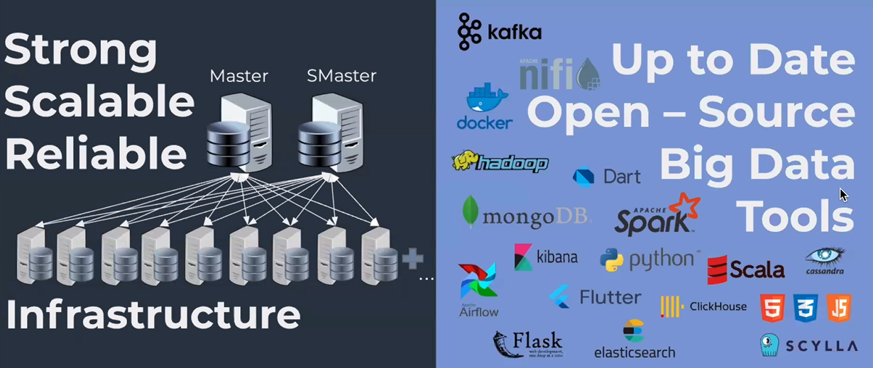
Big Data Infrastructure and Tools

Slide 14
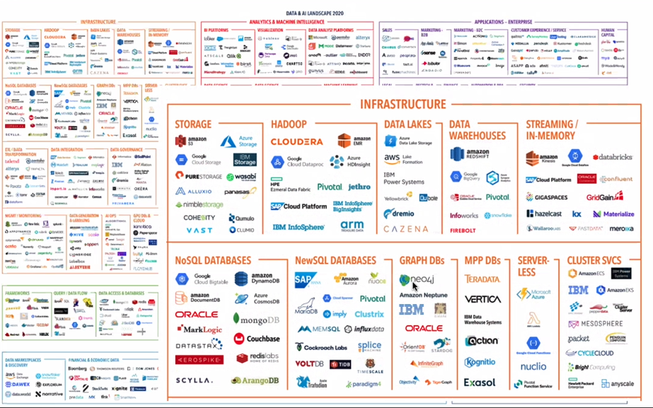
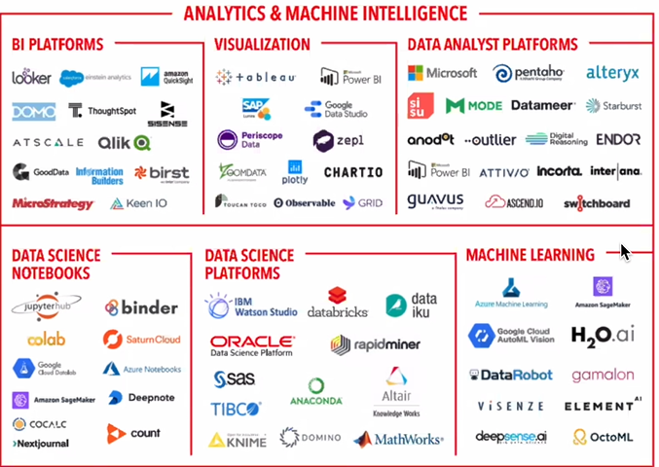

Slide 15
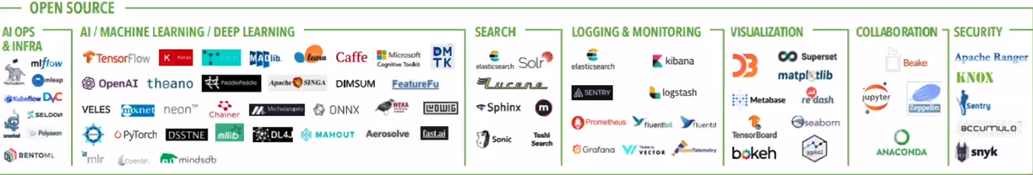
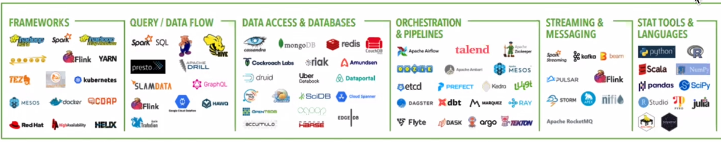

Slide 16
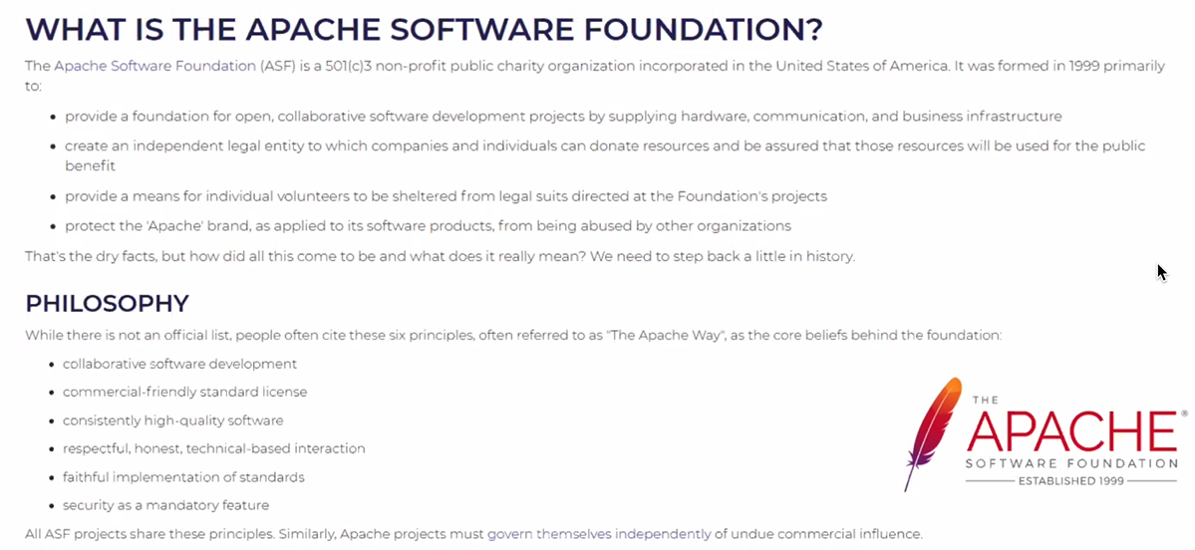
Apache Software Foundation

Slide 17
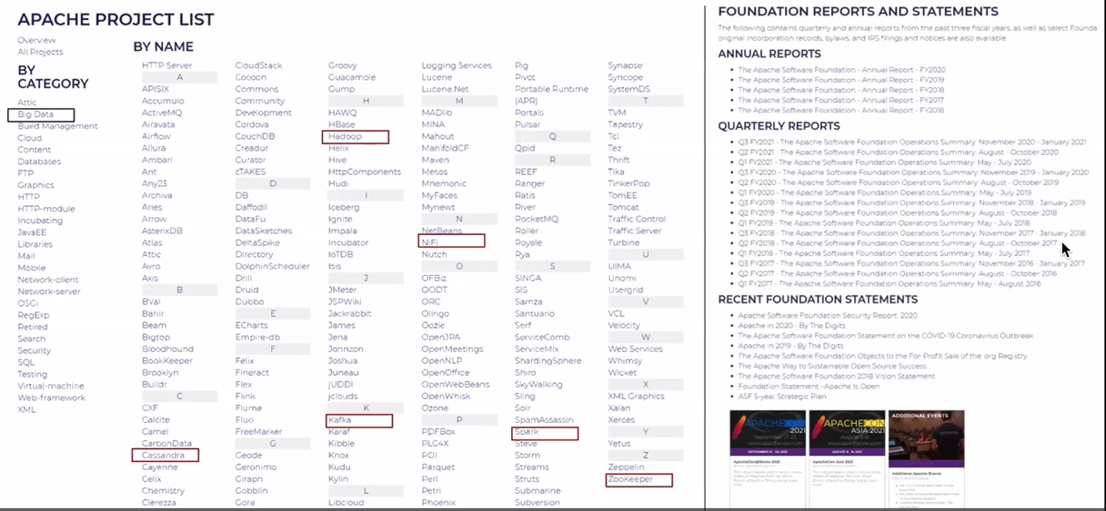
Apache Software Foundation

